Slide 1
High Speed Lane (HSL) Overview HSL Team

Slide 2
Agenda
Vision
What is High Speed Lane (HSL)?
High Speed Lane Framework
Presales Alignment
MVP Use Cases
Automation Approach
HSL in action: GM Canada Showcase
High Speed lane & Use-Case Playbooks
Next Steps
Notes:
Shruti

Slide 3
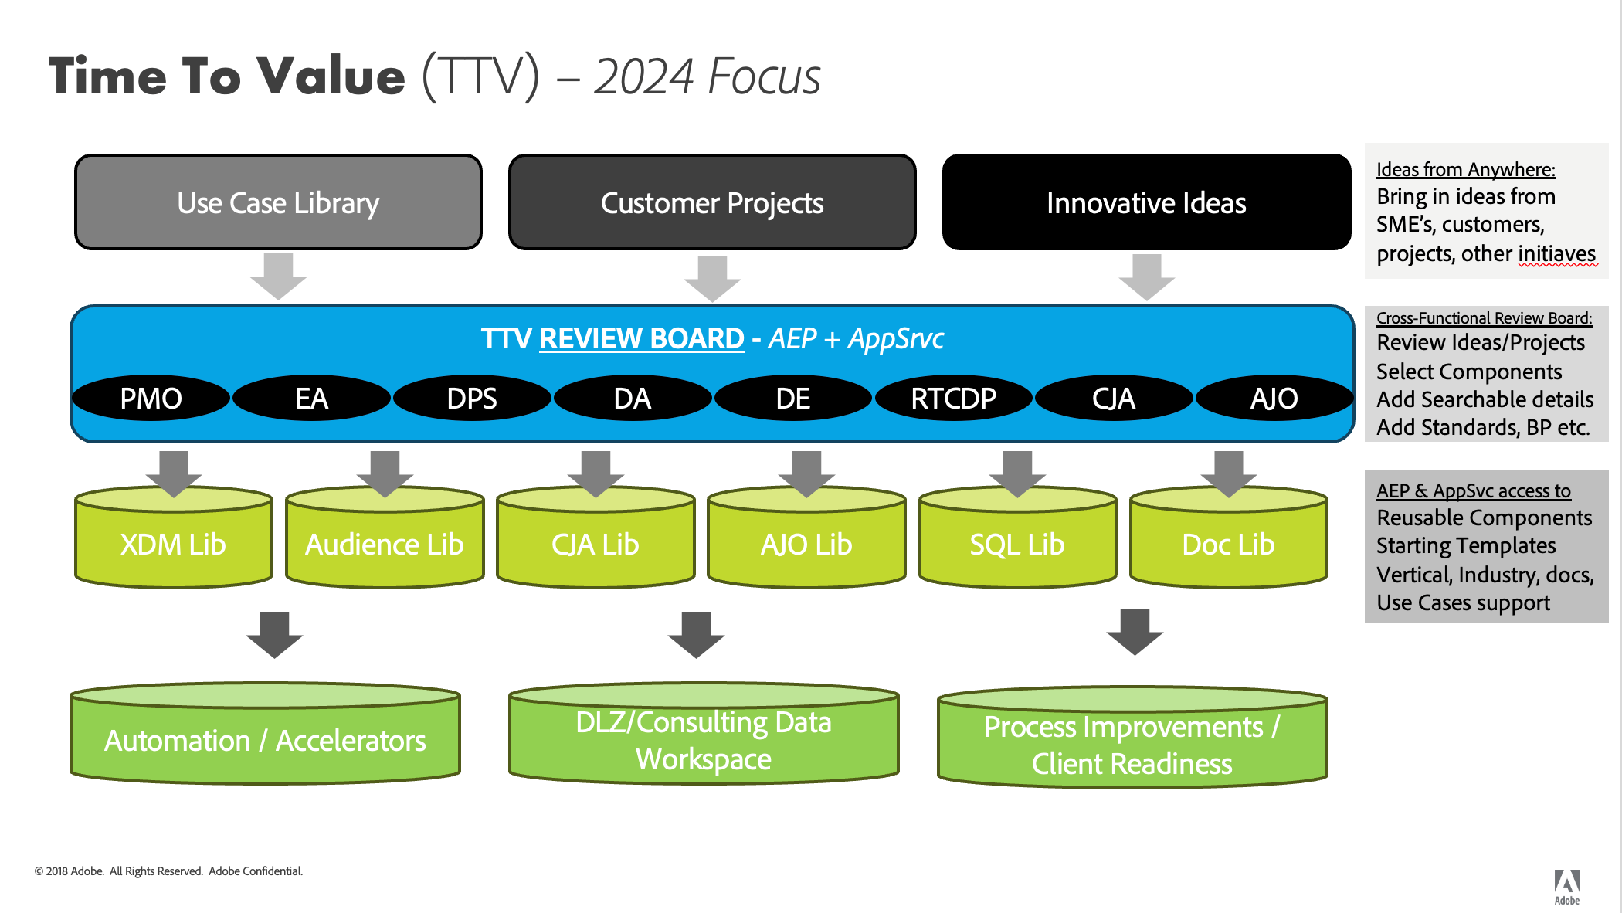
Notes:
Matt

Slide 4
AEP High Speed Lane Package
What it is
A services package that offers a FAST implementation of AEP and at least one app-service within 6 weeks from kick-off to go-live
Packages are limited to a catalogue of use-cases that are supported by this type of engagement
How it Works
Customer Value
1.) Customers who meet HSL readiness requirements choose from a list of HSL enabled use-cases to implement
2.) ACS automates implementation of those use-cases based on ACS IP (pre-built templates)
Huge Time-to-Value savings while still receiving expert guidance from Adobe Customer Solutions to ensure best-practices are followed
Notes:
Shruti

Slide 5
How do we deploy the High-Speed Lane Capabilities
HSL Implementation (4-6 Weeks)
0
1
2
3
4
Presales Alignment
Customer Readiness
Deploy
Foundational Capabilities
Go-Live Readiness
Value & Enablement
Phase II
Scale
Pre-Sales Cycle
Pre-requisite
Pre-Built package
Schema, Datasets
Identities
Segments
Destinations
AJO journeys
CJA templates
Mock Data
Configuration & Prod Data
Sandbox migration
Connector/Destination set up
Configurations in production
Data ingestion and testing
Go Live
Run and Operate
Variations
Marketing campaign
Activation and measurement
Addn’l use cases
Data, Destinations, Journeys, Insights
AI/ML capabilities
Scale
Readiness guide
Alignment
Capability
Use case
Data readiness guide
Provision (Signature)
Training & Enablement
Value Realization
Go Live
Testing
Kick Off
Define
Design
Deployment
Notes:
Shruti

Slide 6
HSL Implementation Framework

Slide 7






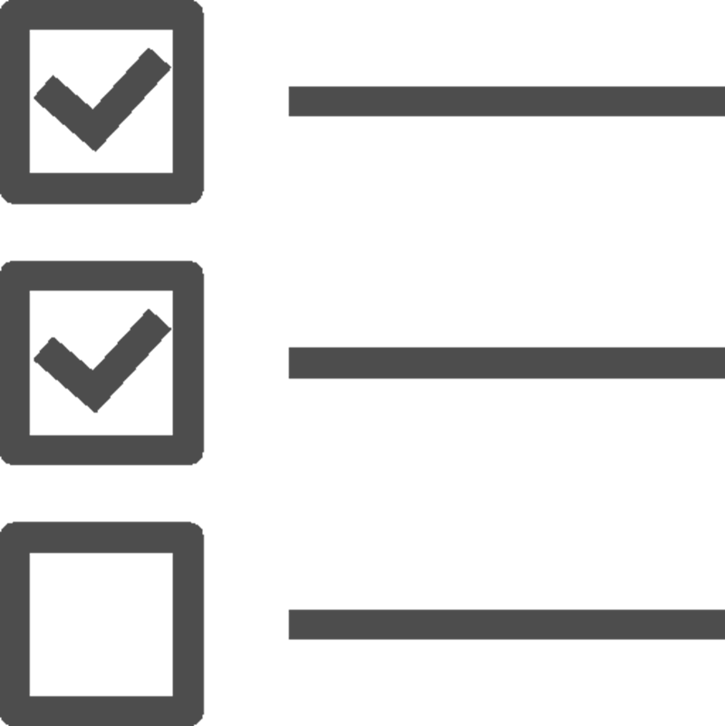



Use Case Framework
01
02
03
04
05
06
07
Use case Discovery
Use case Consolidation
Identities, Attributes, Datatype Field Group Design for Use cases
Use case to Industry Mapping
Creation of the XDM Components
Repository Enrichment
Deployment Automation
Industry level Business Requirement
Translating business requirements into actionable steps
Enhancing the Capabilities

Slide 8
MVP Use Cases
Team is building out materials for a few MVP use-cases that will be supported for our first HSL packages
Customer will choose use-cases and capabilities will be scoped based on a customer’s goals
Use-Case Goal | Use-Case | Verticals | Core Capabilities
Customer Upsell | Drive Loyalty memberships or increased loyalty tiers by reaching existing customers across touchpoints | Telecom, Retail, QSR, Hospitality, Automotive, FSI, and more | Online/Offline Profile, Segmentation, Web Personalization, Email Personalization, Paid Media Personalization, Cross-Channel Measurement
 | Promote repeat transactions by segmenting customers based on purchase or visit frequency, recency, or monetary values and reach them with specific offers
 | Drive product category purchase based on customer product affinity
Customer Acquisition | Drive online form fillouts/logins/sign-ups to increase addressability for in-market consumers and reach them across channels based on behavior
Notes:
Aimee

Slide 9
HSL Presales Alignment & Readiness Requirements
Category | HSL Readiness Item | Requirement Level
Knowledge | Customer has starting foundational knowledge of AEP & prepared to jump into project discussions | HARD
Knowledge | Customer developers, Data Owners have starting technical knowledge (XDM, profile, identity & AEP is NOSQL & not Relational) | HARD
Knowledge | Customer understanding that AEP does NOT serve as EDW, Master Data Management (MDM) or Transactional System, AEP is not a fully featured Data Lake, goal is to bring in just the right data elements and events & and is purely purposed for activating marketing driven use cases | HARD
Knowledge | Customer understands that ETL may be needed from their source data (XDM, denormalization, export & scheduling with ETL resources or Adobe DEIS) | HARD + Add on package Oppty
Knowledge | Customer has reviewed available AEP Data Connectors and ingestion methods, understand limitations and prepared with starting plan | HARD
Knowledge | Customer has understanding about AEP Data Governance Framework to prepare the data and governed their data in AEP platform | HARD
People | Customer has named resources from both marketing & technical to work together to move project forward | HARD
People | Customer has named IT/Developers ready & available at start of project with tools and resources to move quickly (or DEIS pkg) | HARD + Add on package Oppty
People | Customer Data Stewards/Experts, SMEs ready to engage at the start of the project, for each of their identified data sources and for the Data Governance Activity | HARD
Process | Customer can select the use-cases they want to move forward with from HSL library and can identify the data sources needed for each use-case | HARD
Process | Customer security or infosec review and approval to export data to AEP in general for all identified sources | HARD
Process | Customer has designed & prepared for securely exporting their data for each of the identified sources (required for the use cases) | HARD
Process | Customer has approval to share their data/audiences once inside AEP to destinations identified in the use-cases | HARD
Process | Customer is able to provide all necessary destination credentials and has the ability to validate exports in the destination platforms for chosen use-case destinations | HARD
Process | Customer is ready to share key data documentation (along with the data SMEs) available around each of their sources, attribute details, business purposes with ERD diagrams, understand relationships between each of the sources of data. | HARD
Data | Customer has Durable Identifiers for a PERSON/Individual on every data source (record/Event) | HARD
Data | Customer has analyzed their data sources & confident key data is available to meet use cases (customer not mid-project to migrate data to cloud or MDM etc.) | HARD
Data | Customer has representative sample data available and ready to send securely at start of the project | HARD
Data | Customer is able to provide data in the XDM format required for both Sample and Production data (or DEIS pkg) | HARD + Add on package Oppty
Notes:
Aimee

Slide 10
HSL Pilot: GM Canada

Slide 11
Path to Faster Deployment | High Speed Lane Service - GM Canada
Capabilities Delivered:
Schemas:
4 OOTB Analytics,
2- Partial - Profile & 1 Analytics customer (partial),
1- New (Events)
Identities (3- ECID, Consumer ID, #Email)
Profile (1.3 M), Segments (10), Destinations (5)
CJA Dashboards (next up) HSL template ready
Use Cases:
3 use cases type – Cross sell, Re-engagement, Abandon
How we approached
Strong pre-sales alignment
Customer data readiness
HSL project plan and milestones
Combined Use case & Design session
“3” weeks development from provisioning
Lean team – focused SME’s
Use Case, Design &Implement
Project Kick Off
Go Live
Customer Artifacts:
Use Case and approach (pre-sales)
Architecture & Use cases
Data mapping
CDP runbook
Postman scripts
Multiple sessions (TBD)
Environment Provisioned
23rd Sept
30th Oct
17h Nov
Sept
Oct
Nov
Notes:
Shruti

Slide 12
Project Objectives
Overarching Goal of GM Canada AEP Initiative
Bridge unknown to known by stitching together known GM Canada Owner data with pseudonymous website shopping activity to power campaigns across channels: paid media, email, and web personalization
3 Core Capabilities
3 High Value Use-Cases
✓ Connect known customers to unknown profiles
✓ Reach known and unknown customers with web personalization
✓ Remarket to known and known customers with paid media
UC1: Identify Customers Under Contract that are In-Market to Drive Repurchase with Cross-channel messaging
UC2: Reach Hot Leads with a Paid Media Campaign to drive re-engagement
UC3: Re-engage to ”Build your own” Site Abandoners Across Channels
Notes:
Aimee

Slide 13
UC3: Re-engage to BYO Abandoners Across Channels
Description
Remarket to those who start to Build their Own vehicle (BYO) but do not complete, with an email campaign where they are known customers and with a paid media campaign where they are unknown customers to drive additional site engagement
Capabilities
✓ Connect Known to Unknown Profiles³
✓Remarketing to Paid Media Channels (Unknown)
Value
Improved efficiency of paid media channels by leveraging suppression of known customers
Increased lead submissions and online engagement with the ability to reach web-based behavior with offline communication
Measurement Plan
Paid Media: Efficiency gained through suppression (Size of known being suppressed)
Paid Media: Decrease in CPA and lift in hand-off rate (from DSP / Ad Server) ⁵
Email & Paid Media: Engagement onsite (KSAs) using campaign ID (event code) in Click-Thru URL ⁶
Audience
Destinations
Audience Description | Data Sources | Channel
Reach known BYO starts (without completes after x days) with Email ¹ | CDR Consumer Profile, Adobe Analytics | Email
Reach known BYO starts (without completes after x days) excluding email¹ | CDR Consumer Profile, Adobe Analytics | Paid Media
EXCLUSION: Customers who purchased in the last 12 months² | CDR Consumer Vehicle, CDR Consumer Profile | Paid Media
Destination Name | Matching ID | Exported Fields
Google DV360 | ECID (Cookie Sync) | Segment Membership
Google Customer Match⁴ | Hashed Emails | Segment Membership (Exclusion)
The Trade Desk | ECID (Cookie Sync) | Segment Membership
CDR (Email) (Sterling SFTP) | Consumer ID | Segment + Web Activity (KSAs)*
*Export of web activity to CDR still to be defined during solution phase
Considerations / Assumptions
¹Adobe has agreed to build one segment based on a single make/model for GMCA to copy as they expand to other makes/models.
²Exclusion audience will be made up of hashed emails and will not be actionable on TTD through the cookie sync destination. This audience can be shared to DV360 via Google Customer Match as long as sharing settings in Google allow this and Google does not restrict this exclusion on their side
³This setup will not require an email click-thru, but today customer ID will only be captured upon prior email click-thru which will be the basis of all connected profiles between known and unknown. GMCA agreed to make a small implementation change to support this before we start ingesting data
⁴GMCA team needs to gain approval to share hashed emails with paid media partners directly before Adobe can activate
⁵We assume that the GMCA team will provide reporting from paid media sources and will include KPI baselines as success criteria
⁶Reporting in Adobe will be done in Adobe Analytics with campaign and event codes associated only to AEP audience powered line items provided by the GMCA team. This will measure direct click-thru only
*Full segment logic on next slide
Notes:
Aimee

Slide 14
HSL Next Steps

Slide 15
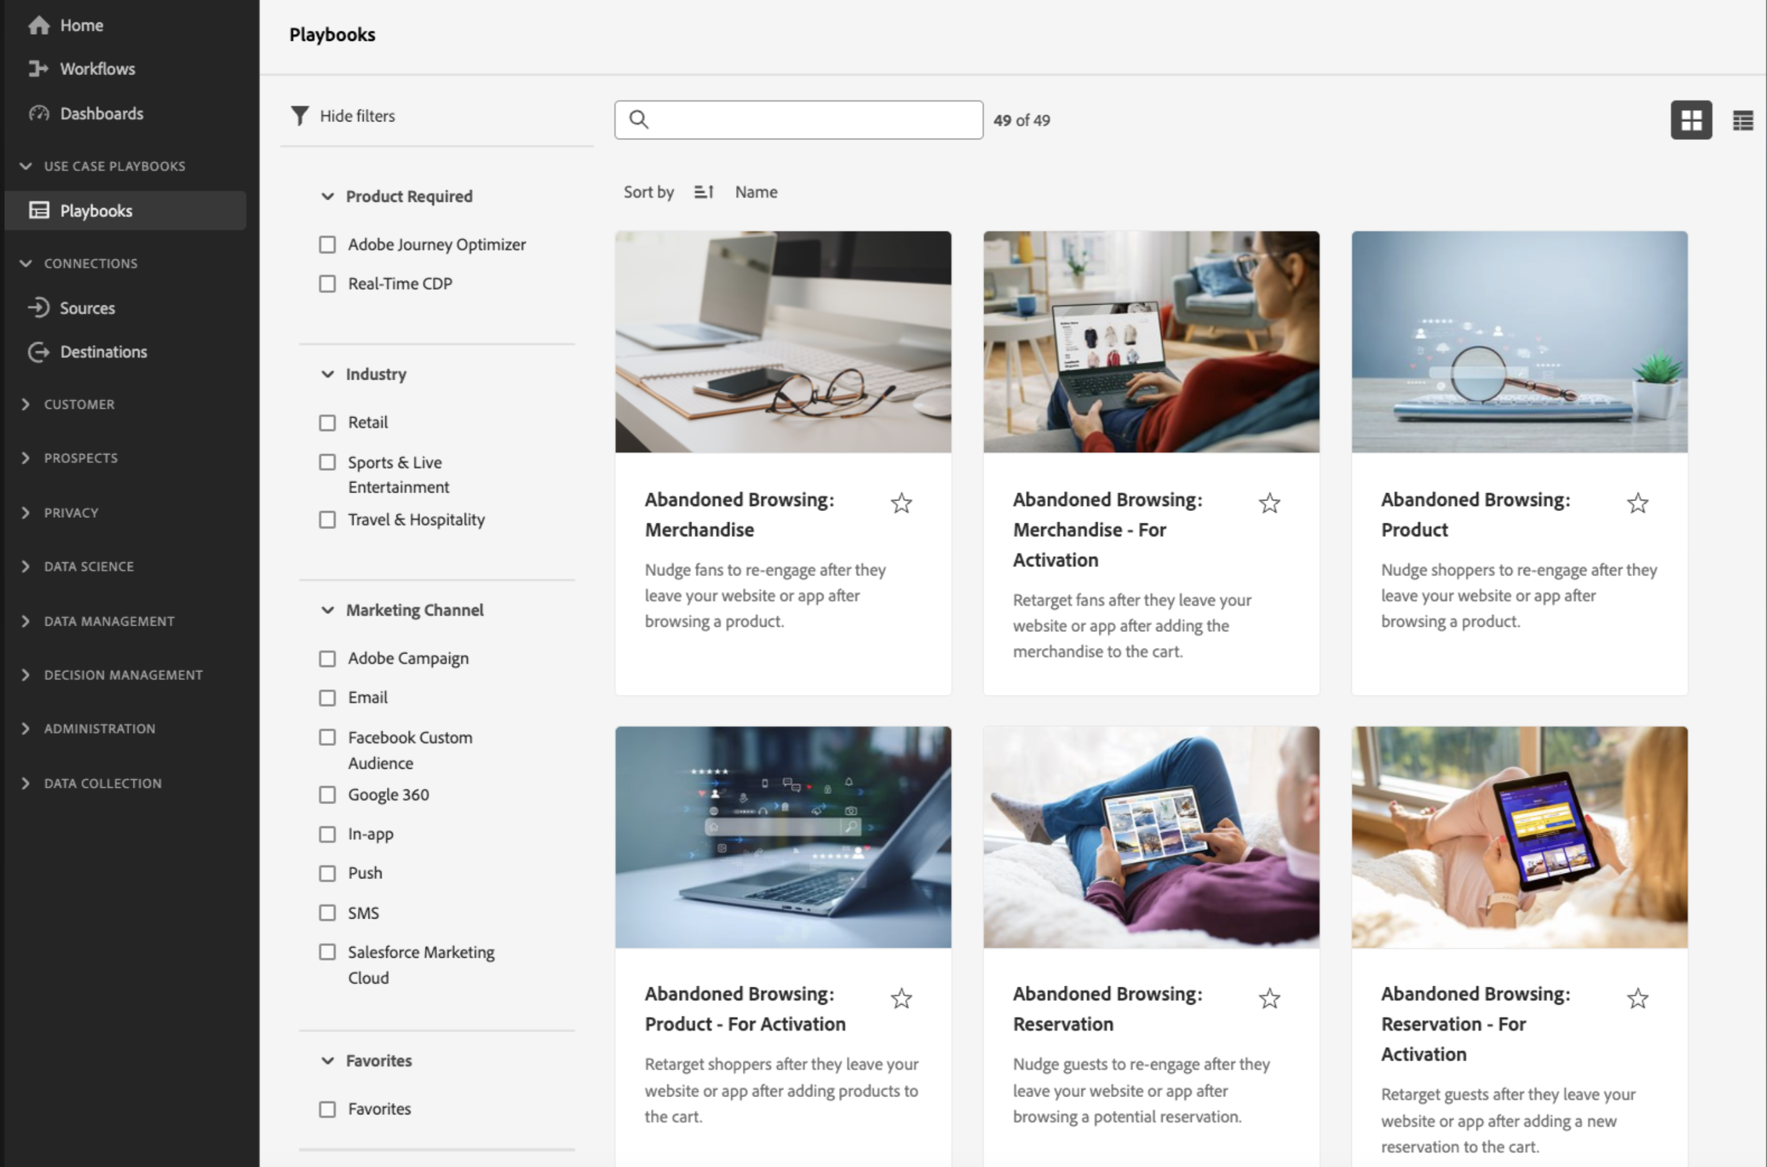
HSL x Use-Case Playbooks
Vision to include ACS specific playbooks for HSL engagements to further automate
ACS playbooks can be made only available to HSL or ACS customers
Notes:
Aimee / Shruti to go through. Voice over how PIE fits in.

Slide 16
Why High Speed Lane?
Scale ACS thought leadership and best practices for Adobe Experience Platform
Create our own IP to offer packages customers cannot get elsewhere
Better compete with partners by driving value faster with high quality implementations
Notes:
Matt

Slide 17
Join our team!
Help us build out HSL packages from the ground up! Reach out to an HSL team-member if you want to join.
We need all AEP/App Service/Strategy skillsets to help us scale this initiative!
EAs
Strategists/BCs
DE
CJA
RTCDP
AJO
Role | Current Team
Enterprise Architect | Gabein Davis, Michael Harke
Data Architect | Sagin PG, Shakti Nayak, Shruti Jagtap, Ryan Wilson, Kanagalaskmi Jayaraman, Craig Fitches, Cody Field
RTCDP Consultant | Aimee Gregg, Nicholas Cammuso
AJO Consultant
CJA Consultant | Claire Chen, Bryan Skelton
Strategists/BCs
Notes:
Shruti

Slide 18
Appendix

Slide 19
HSL methodology compared to normal implementation for RTCDP
Significanlty faster (>50%)
Somewhat Faster (>20%)
Normal
UC discovery
Data Discovery
Schema Design
Data Ingestion (Dev)
Audience Creation + Validation
Destination Creation + Testing
Data Ingestion (PROD)
Go-Live
Customer enters implementation knowing what Use-cases and foundational capabilities we are going to implement. This greatly reduces discovery time as conversations can immediately become more tactical
Presales to generate list of data sources, identities, and limited # of fields (60-70). This greatly reduces data discovery needed
Library of materials could be referenced to significantly reduce time to design schemas with API packages to quickly implement
Mock data examples for each use-case can be developed as part of libraries for customers to use as an example.
Require HSL customers to give XDM compliant development data to reduce ingestion time
Pre-defined logic exists for UCs with prebuild schemas, but sandbox automation could significantly decrease this time
Requires customer to provide requirements and to login. Also requires customer for validation in external platforms
Require HSL customers to give XDM compliant files to reduce ingestion time.
Consultant data workspace (newly live) will also help consultants quicken ingestion
HSL Tools Used
Presales alignment
Catalogue of HSL use-cases and capabilities
Presales alignment
Defined HSL customer readiness requirements
HSL Use-Case XDM Library
Sandbox Tooling
HSL Use-Case Mock Data Library
Defined HSL customer readiness requirements
HSL Use-Case Audience Library
Sandbox Tooling
Destination requirements + testing templates
Defined HSL Customer readiness requirements
Consultant Data Workspace
Notes:
Canada gave us XDM compliant files Consultant data workspace is now live.

Slide 20
What is High-Speed Lane?
High-Speed Lane (HSL) is a services package that offers a FAST implementation of 6 weeks from kick-off to go-live.
Customers will pick from a list of supported use-cases during pre-sales
ACS will automate implementation using generic developed components such as schemas, audiences, and more
Customers will be required to meet specific readiness criteria to qualify for HSL projects
Why High-Speed Lane?
Drive Adoption of both ACS services and AEP/App Services. Many customers have purchased AEP and App Services, but are not using them.
Expand ACS strategy to focus on quickly scaling AEP/App Services for customers and drive revenue
How is High Speed Lane different from....
Use-case Playbooks: High-speed lane projects support more complex use-cases using ACS delivery services
PIE: ?
Project Amplify: HSL assumes use-cases/journeys are pre-selected where Project Amplify recommends journeys based

Slide 21
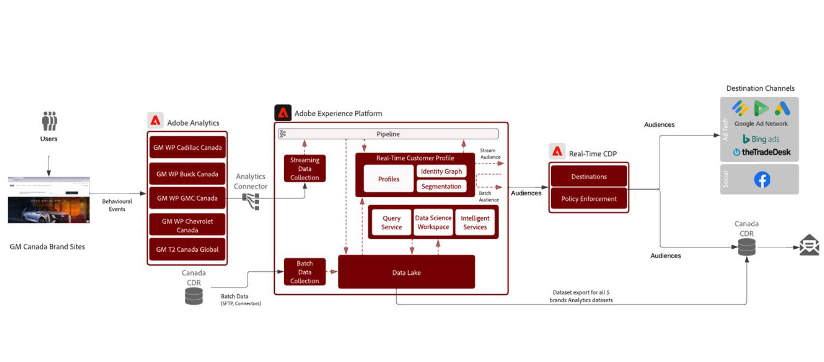
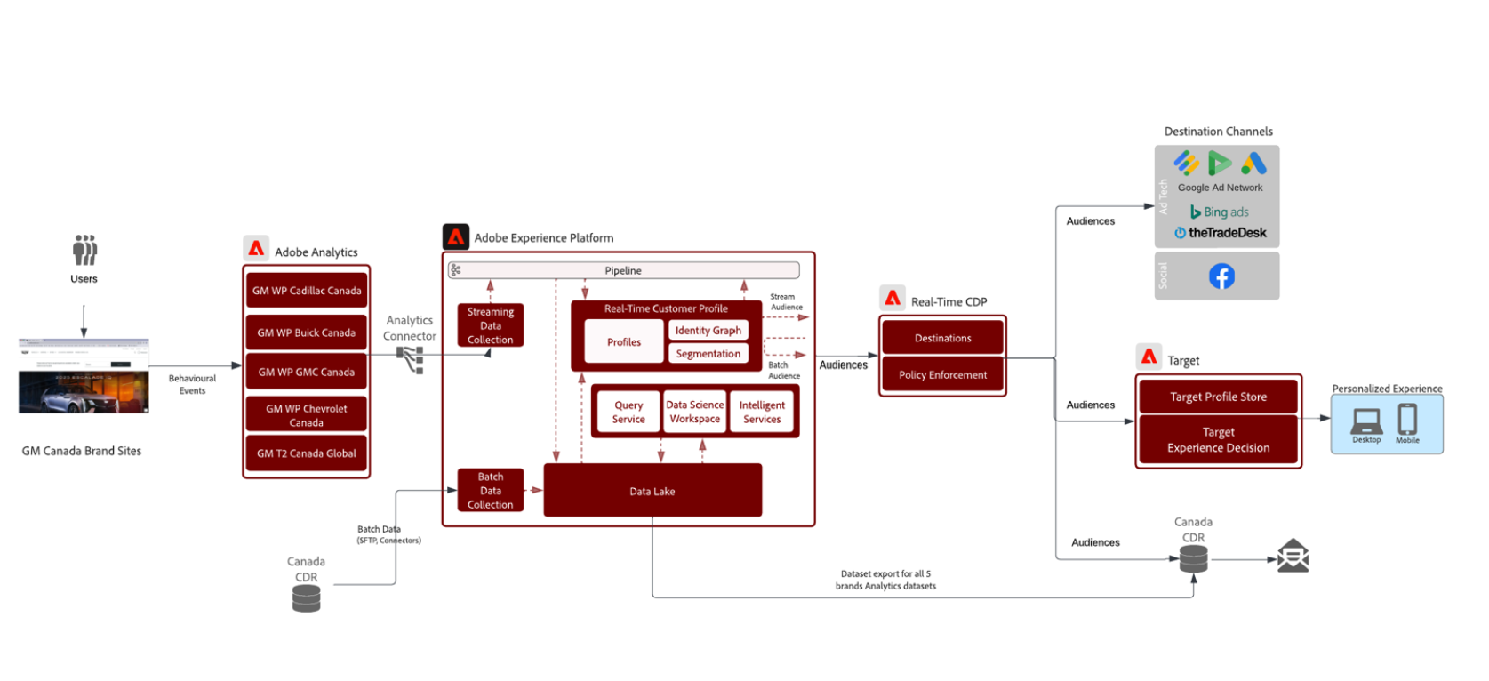
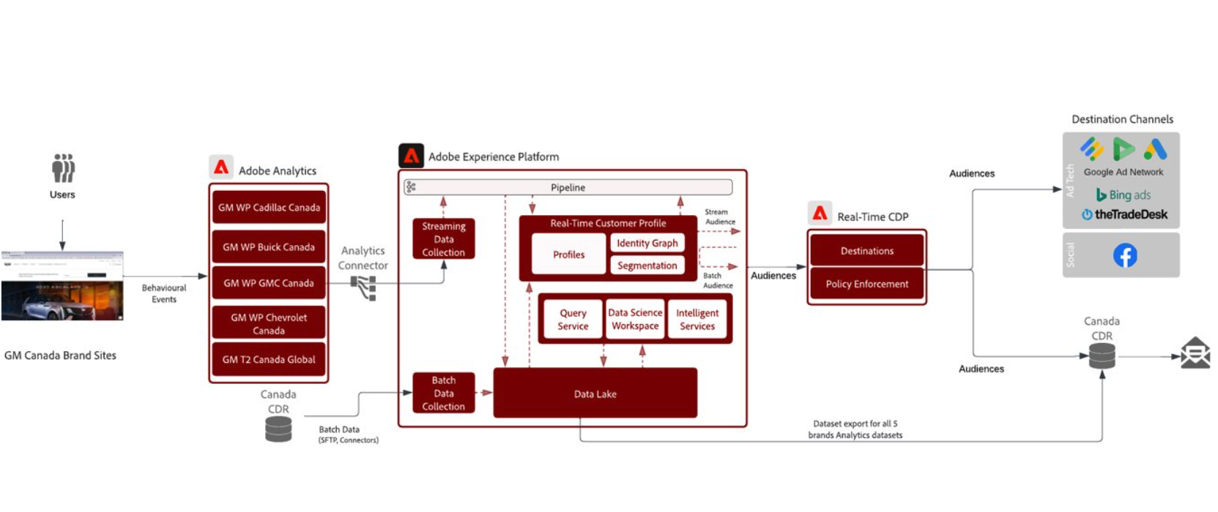
Promotion at Summit
Highlight HSL Supported Use-cases and talk through them with customers at the ACS Booth. Potential to raffle/discount services
1
2
3
Re-engage Cart or Site Abandoners Across Channels
Drive In-Market customers to purchase by recognizing them onsite
Engage Hot Leads / High Value audiences with people-based paid media
Showcase architectural diagrams, audience examples, and more 1:1 with prospective customers in ACS booth

Slide 22
Use Case Playbook vs PIE-HSL PoV
Sl. No. | Use Case Playbook | PIE-HSL
1 | Limited set of use cases. | PIE-HSL use cases are iterative in nature which follows a use case marketplace model i.e., Use case repository keeps on enriching on a periodic basis.
2 | Most of the use cases are skewed towards online channels. | Use cases are factors in online & offline channels of enterprise grade.
3 | Web schemas have PII as the identifier. schemas i.e. web-based event schemas have EmailId as the identifier, these are PIIs hence this could pose a risk when the customer has stringent privacy and GDPR requirements | Non PII based approach. Identities in PIE-HSL are based on industry standard and experience from past implementations.
4 | Identity inelastic . Identities are fundamental for ID graph & profile stitch. Playbook also involves OOB audiences & AJO which are dependent on the identities hence we need to be sure how playbook handles this customization | Identity Flexible. PIE-HSL enables customization around identities. This scope & effort is factored in during data discovery & build
5 | Flexibility to involve testing & validation at each step . Since all the XDM components i.e. schemas , datasets , segments & AJO journeys are created with a click of a button . Imagine inconsistent data has been keyed in . The client may have to reset the sandbox. Ideally there should be a data validation between schema and dataset creations and audience & ajo journey creation | PIE-HSL provides the flexibility to accommodate additional steps for validation and testing in between the automation .
6 | Current Strategy is to augment existing XDM in the higher environments. Tool needs to be flexible to create XDMs in a green field implementation. | PIE-HSL is limited here as currently it supports only green field/fresh sandbox implementations.

Slide 23
Recommended HSL Tasks to scale
Key tasks:
Create a phased rollout of use-cases and core capabilities for each app service
Work with sales to define menu of options that we can give to HSL customers
Define data readiness requirements for HSL customers
Create templates for HSL BRD, Destination testing, Destination testing (& requirements gathering), Selection of Customer Enablement Sessions, etc. to further increase implementation speed
Define sandbox strategy for where UC materials can go and define how Sandbox Tooling (customer engineering) can help us copy into customer sandboxes
Execute sandbox strategy and create UC materials in sandboxes
Key timelines and milestones for all of the above
Ideas that have been brought up:
Create sandboxes by industry and break out use-cases by industry with specific industry teams to execute creation of technical materials

Slide 24
Our Approach – Foundational Capability to Use Case Type to Industry Variation
Who, What, Where
Foundational Capability
High Speed Lane Package
‘5’ Use Case Types
High Speed Lane Package
Use Case Industry Variation by Marketers
Real time 1:1 personalized message based on behavioral and geo-location data
Retail- Geo location Targeting
T&H – Target based on location for hotel
In Vehicle – Target based on location for hotel
Source Connectors – OOTB
Schemas, Datasets, Identities
Member welcome campaign
Retail- Member welcome for purchase
Generic - Member welcome for registration
Segments
Product affinity campaign
Retail- Active campaigns based on member affinity data
T&H – Active campaign based on hotel affinity
CDP Destinations
Offline and Web behavioral
re-targeting on Cross channel
Retail- Product abandon journey
T&H - Purchase abandon journey
In Vehicle - Accessories purchase abandon
AJO: 1:1 personalized customer journey
CJA - Dashboards
Web Campaign measurement
Generic –Customer engagement dashboard
Notes:
Project Amplify;

